Slide 1
HMRC UK House Price - Data Analysis
By Eloho Mukoro

Slide 2
The Problem Statement
This analysis aims to provide insights into the UK house price sector using data from the HMRC department in the Civil Service organization. The aim will be on identifying key trends, regional variations, and significant changes over time.
The 3 main problem areas are focused on the following:
Economic Stability and Affordability
Resolve Regional Disparities
Impact of Cash Sales

Slide 3
Tasks and Actions
Data Preparation
Statistical Analysis
Perform Analysis
Visualization
Results
Results
Visualization - Pivot Table
Result Findings
Recommendation
Data Preparation
Load Dataset - Python
Load Libraries - Python
Data Cleaning - Python
Data Analysis Implementation
Statistical Analysis - Excel
Exploratory Analysis - Python

Slide 4
Implementation Analysis
Missing Data | Count
AveragePriceSA | 23400
SalesVolume | 405
DetachedPrice | 720
SemiDetachedPrice | 720
TerracedPrice | 720
FlatPrice | 660
CashPrice | 780
CashSalesVolume | 1172
MortgagePrice | 780
MortgageSalesVolume | 1229
FTBPrice | 780
FOOPrice | 780
NewPrice | 1133
NewSalesVolume | 2870
OldPrice | 1054
OldSalesVolume | 1064
OldPrice | 1054
Dataset Details:
The dataset contained 21 features and 24300 rows.
The table had missing data in the following columns.
Tools used: Python and Excel.

Slide 5
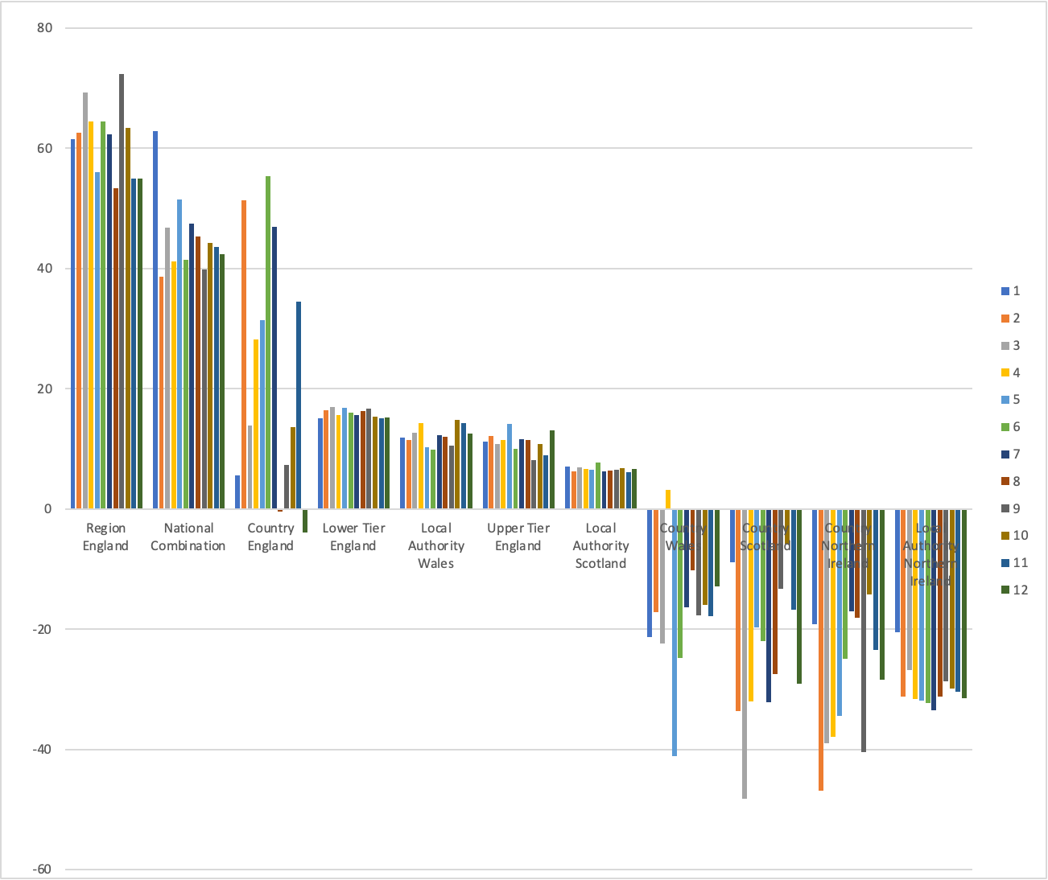
Results - 1
In what Region and Month did the largest 12-month percentage change occur?
To identity the “Region” and “Month” with the largest 12-month percentage value, the date stamp was categorized into “Years” and “Months” separately in columns using some functions such as:
“Month(M2)”, “Year(Y2)”
The 12-month percentage column was created by filtering the records in ascending order and calculating the past year records using the function below:
“IFERROR/OFFSET”
With the newly created feature records, it was easy to calculate the 12-month % with the results below using a pivot table from Excel.
Largest record:72%
RegionName: RegionEngland
Month: 9

Slide 6
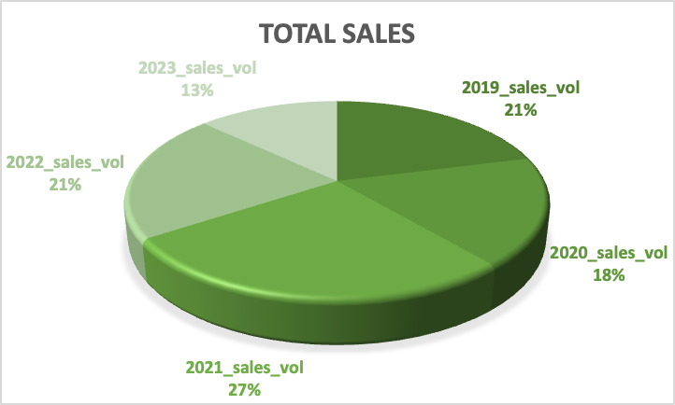
Results - 2
What was the total number of sales across the UK in 2021?
The total number of sales recorded in the UK was obtained by using the newly created “Year” column to classify the records.
Using the filter to select the “Years” in ascending order and the use of the “=SUMIFS(U2:U24301, Z2:Z24301, Y)” function to display the range of “SalesVolume”, the criteria of the selected “Year” and the specific year.
The total across the selected years were displayed. The total number of sales in UK for the year 2021 was 7,923,739.
Year_Sales | Volume
2019_sales_volume | 6177344
2020_sales_volume | 5231286
2021_sales_volume | 7923739
2022_sales_volume | 6264167
2023_sales_volume | 3820283.667
Total_Sales_Volume | 29,416,819.67

Slide 7
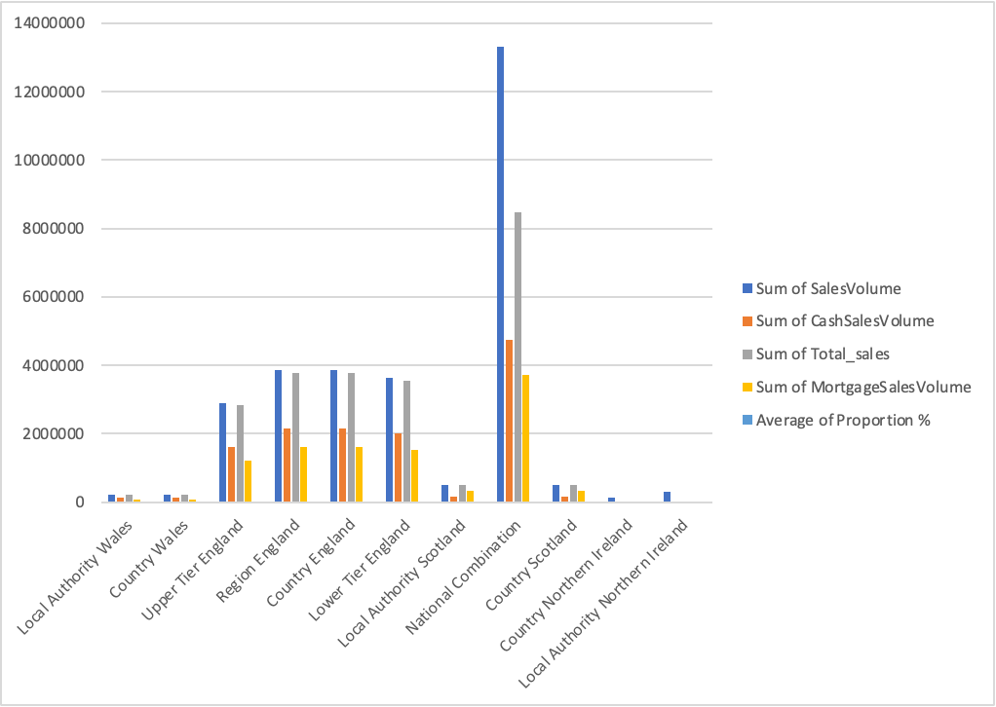
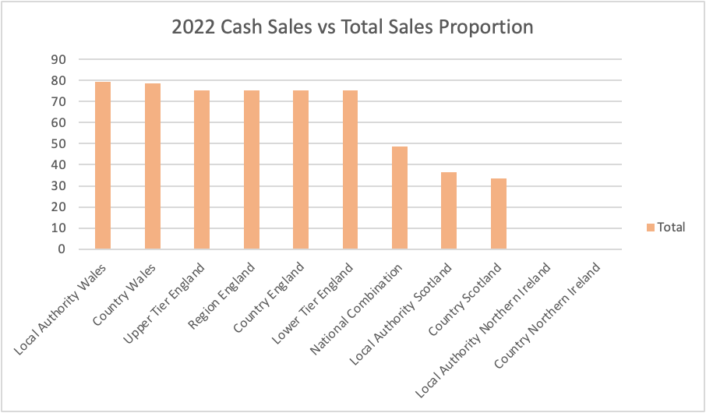
Results - 3
For 2022, which Region had the largest proportion of cash sales to total sales?
In 2022, the region with the largest proportion of cash sales to total sales was Local Authority Wales with the average percentage of 79%.

Slide 8
Summary and Recommendation
National Combination Region
In conclusion, there are a couple of areas that have impacted the UK house pricing and the concerns encountered.
The National Combination Region had the highest record of Sales Volume from 2019 - 2023.
While performing Data cleaning using python, a lot of data was lot which impacted the results for data analysis.
There are a total of “5594176.667” Sales value missing records from total sales volume in 2 Regions (Country Northern Ireland and Local Authority Northern Ireland) that have been recorded in total “SalesVolume” but have not been recorded in the “CashSalesVolume” and the “MortgageSalesVolume”.
Over 70% of realtors acquire UK house properties through Cash Sales rather than Mortgage sales across all regions.
Only 900 of the “AverageSalesSA” records were captured in the dataset, hence to avoid discrepancies it is advised to make this compulsory in order to aid further predictions in the future.

Slide 9
THANK YOU

